Slide 1
Fall 2020
CSE 422: Artificial Intelligence
Topic – 4: Local Search
Department of Computer Science and Engineering

Slide 2
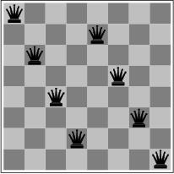
Local Search Algorithms and Optimization Problems
Previously: systematic exploration of search space
  Path to goal is solution to problem
for some problem classes, it is sufficient to find a solution
  the path to the solution is not relevant, e.g. 8-queens
Different algorithms can be used
  Local search
memory requirements can be dramatically relaxed by modifying the current state
  all previous states can be discarded
  since only information about the current state is kept, such methods are called local

Slide 3
Local Search Algorithms and Optimization Problems
Local search = use single current state and move to neighboring states.
Advantages:
  Use very little memory
  Find often reasonable solutions in large or infinite state spaces.
Are also useful for pure optimization problems.
  Find best state according to some objective function.
  e.g. survival of the fittest as a metaphor for optimization.

Slide 4

Local Search Algorithms and Optimization Problems

Slide 5
Hill-Climbing Search
continually moves uphill
  increasing value of the evaluation function
  gradient descent search is a variation that moves downhill
is a loop that continuously moves in the direction of increasing value - that is, uphill.
  It terminates when a peak is reached.

Slide 6
Hill-Climbing Search
Hill-climbing does not look ahead of the immediate neighbors of the current state.
Hill-climbing chooses randomly among the set of best successors, if there is more than one.
Hill-climbing is also called greedy local search
Hill-climbing is a very simple strategy with low space requirements
  stores only the state and its evaluation, no search tree

Slide 7
Hill-Climbing Example
8-queens problem (complete-state formulation).
Successor function: move a single queen to another square in the same column.
Heuristic function h(n): the number of pairs of queens that are attacking each other (directly or indirectly).

Slide 8
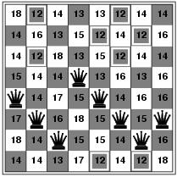

Hill-Climbing Example
(a)
(b)
(a) An 8-queens state with heuristic cost estimate h = 17, showing the value of h for each possible successor obtained by moving a queen within its column. The best moves are marked.
(b) A local minimum in the 8-queens state space; the state has h = 1 but every successor has a higher cost.

Slide 9
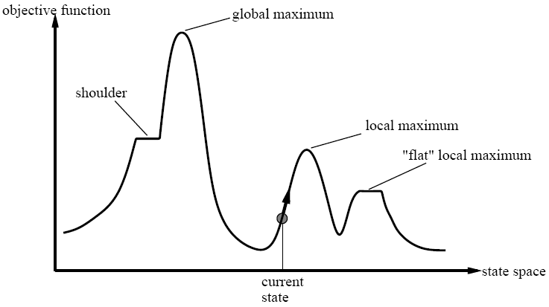

Slide 10
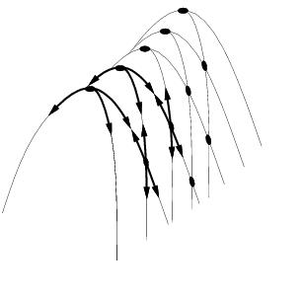
Drawbacks
Ridge = sequence of local maxima difficult for greedy algorithms to navigate
Plateaux = an area of the state space where the evaluation function is flat.
Gets stuck 86% of the time.

Slide 11
Hill-Climbing Search
problems
  local maxima
    algorithm can’t go higher, but is not at a satisfactory solution
  plateau
    area where the evaluation function is flat
  ridges
    search may oscillate slowly

Slide 12
Escaping Local Optima
HC gets stuck at local maxima limiting
the quality of the solution found.
Two ways to modify HC:
  choice of neighbor
  criteria for accepting neighbor for current
For example:
  choose neighbor randomly
  accept neighbor if it is better or
  if it isn't, accept with some fixed probability p

Slide 13
Escaping Local Optima
Modified HC can escape local maxima but:
  chance of making a bad move is the same
  at the beginning of the search as at the end
  magnitude of improvement or lack of is ignored
How can HC address these concerns?
  fixed probability p that bad move is accepted
  can be replaced with a probability
  that decreases as the search proceeds
  now as the search progresses,
  the chances of taking a bad move reduces

Slide 14
Hill-Climbing Search
function HILL-CLIMBING( problem) return a state that is a local maximum
input: problem, a problem
local variables: current, a node.
neighbor, a node.
current ← MAKE-NODE(INITIAL-STATE[problem])
loop do
neighbor ← a highest valued successor of current
if VALUE [neighbor] ≤ VALUE[current] then return STATE[current]
current ← neighbor

Slide 15
Hill-Climbing Variations
Stochastic hill-climbing
  Random selection among the uphill moves.
  The selection probability can vary with the steepness of the uphill move.
First-choice hill-climbing
  implements stochastic hill climbing by generating successors randomly until a better one is found.
Random-restart hill-climbing
  Tries to avoid getting stuck in local maxima.

Slide 16
Simulated Annealing
Escape local maxima by allowing “bad” moves.
  Idea: but gradually decrease their size and frequency.
Origin; metallurgical annealing
Bouncing ball analogy:
  Shaking hard (= high temperature).
  Shaking less (= lower the temperature).
If T decreases slowly enough, best state is reached.
Applied for VLSI layout, airline scheduling, etc.

Slide 17
Simulated Annealing
function SIMULATED-ANNEALING( problem, schedule) return a solution state
input: problem, a problem
schedule, a mapping from time to temperature
local variables: current, a node.
next, a node.
T, a “temperature” controlling the probability of downward steps
current ← MAKE-NODE(INITIAL-STATE[problem])
for t ← 1 to ∞ do
T ← schedule[t]
if T = 0 then return current
next ← a randomly selected successor of current
∆E ← VALUE[next] - VALUE[current]
if ∆E > 0 then current ← next
else current ← next only with probability e^{∆E /T}

Slide 18
Local Beam Search
Keep track of k states instead of one
  Initially: k random states
  Next: determine all successors of k states
  If any of successors is goal → finished
  Else select k best from successors and repeat.
Major difference with random-restart search
  Information is shared among k search threads.
Can suffer from lack of diversity.
  Stochastic variant: choose k successors at proportionally to state success.

Slide 19
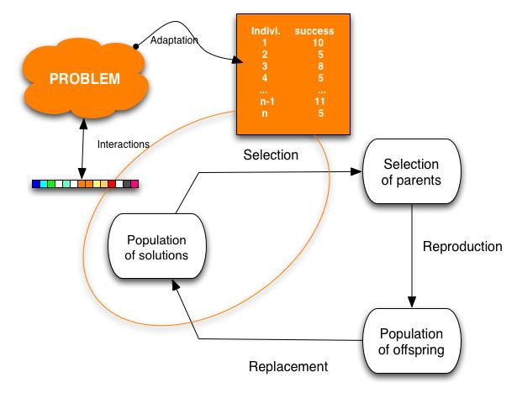
Genetic Algorithms
Variant of local beam search with sexual recombination.

Slide 20
Genetic Algorithms
GAs begin with a set of k randomly generated states, called the population.
Each state, or individual, is represented as a string over a finite alphabet—most commonly, a string of 0s and 1s.
For example, an 8-queens state must specify the positions of 8 queens, each in a column of 8 squares, and so requires 8 x log₂ 8 = 24 bits.
Alternatively, the state could be represented as 8 digits, each in the range from 1 to 8.
Figure 4.6(a) shows a population of four 8-digit strings representing 8-queens states.

Slide 21

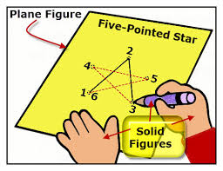
Genetic Algorithms
Figure 4.6: The three major operations in genetic algorithm. The initial population in (a) is ranked by the fitness function in (b), resulting in pairs for mating in (c). They produce offspring in (d), which are subject to mutation in (e).

Slide 22

Genetic Algorithms
The 8-queens states involved in this reproduction step are shown in Figure 4.7.
Figure 4.7: The 8-queens states corresponding to the first two parents in Figure 4.6(c) and the first offspring in Figure 4.6(d).

Slide 23
Genetic Algorithms
The production of the next generation of states is shown in Figure 4.6(b)–(e).
In (b), each state is rated by the objective function, or (in GA terminology) the fitness function.
A fitness function should return higher values for better states, so, for the 8-queens problem we use the number of nonattacking pairs of queens, which has a value of 28 for a solution.
The values of the four states are 24, 23, 20, and 11.
In this particular variant of the genetic algorithm, the probability of being chosen for reproducing is directly proportional to the fitness score, and the percentages are shown next to the raw scores.

Slide 24
Genetic Algorithms
In (c), two pairs are selected at random for reproduction, in accordance with the probabilities in (b).
Notice that one individual is selected twice and one not at all.
For each pair to be mated, a crossover point is chosen randomly from the positions in the string.
In Figure 4.6, the crossover points are after the third digit in the first pair and after the fifth digit in the second pair.
In (d), the offspring themselves are created by crossing over the parent strings at the crossover point.
For example, the first child of the first pair gets the first three digits from the first parent and the remaining digits from the second parent, whereas the second child gets the first three digits from the second parent and the rest from the first parent.

Slide 25
Genetic Algorithms
The 8-queens states involved in this reproduction step are shown in Figure 4.7.
Figure 4.7: The 8-queens states corresponding to the first two parents in Figure 4.6(c) and the first offspring in Figure 4.6(d).

Slide 26
Genetic Algorithms
The example shows that when two parent states are quite different, the crossover operation can produce a state that is a long way from either parent state.
It is often the case that the population is quite diverse early on in the process, so crossover (like simulated annealing) frequently takes large steps in the state space early in the search process and smaller steps later on when must individuals are quite similar.

Slide 27
Genetic Algorithms
Finally, in (e), each location is subject to random mutation with a small independent probability.
One digit was mutated in the first, third, and fourth offspring.
In the 8-queens problem, this corresponds to choosing a queen at random and moving it to a random square in its column.

Slide 28
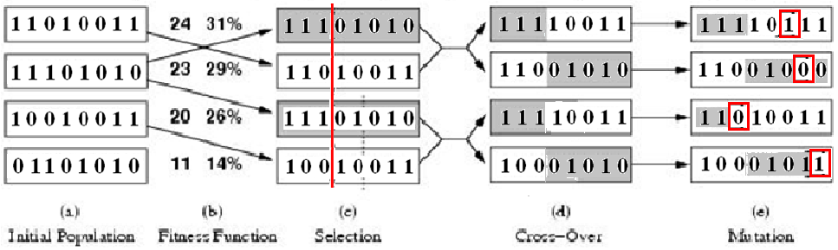
Genetic Algorithms
Figure: A genetic algorithm. The algorithm is the same as the one diagrammed in the figure in slide no. 45, with one variation: in this more popular version, each mating of two parents produces only one offspring, not two.

Slide 29
Genetic Algorithms
function GENETIC_ALGORITHM( population, FITNESS-FN) return an individual
input: population, a set of individuals
FITNESS-FN, a function which determines the quality of the individual
repeat
new_population ← empty set
loop for i from 1 to SIZE(population) do
x ← RANDOM_SELECTION(population, FITNESS_FN) y ← RANDOM_SELECTION(population, FITNESS_FN)
child ← REPRODUCE(x,y)
if (small random probability) then child ← MUTATE(child )
add child to new_population
population ← new_population
until some individual is fit enough or enough time has elapsed
return the best individual

